Slide 1
Chapter 6
Software testing

Slide 2
Software verification
Verification testing includes different activities such as business requirements, system requirements, design review, and code walkthrough while developing a product.
Static testing, cheks"we are developing the right product or not".
Ensures that the developed application is fulfilling all the requirements given by the client.

Slide 3
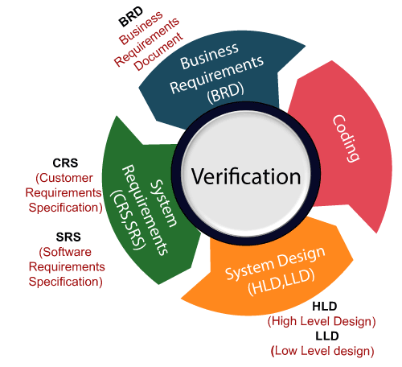
Software verification

Slide 4
Validation testing
Validation testing is testing where the tester performed functional and non-functional testing.
Functional testing includes Unit Testing (UT), Integration Testing (IT), and System Testing (ST),
Non-functional testing includes User acceptance testing (UAT).
Validation testing is also known as dynamic testing, where we are ensuring that "we have developed the product right."
And it also checks that the software meets the business needs of the client.

Slide 5
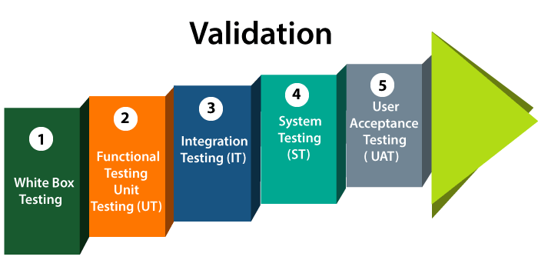
Validation testing

Slide 6
Difference between verification and validation
Verification
Validation
It includes checking documents, design, codes and programs.
Verification is the static testing.
It does not include the execution of the code.
Methods used in verification are reviews, walkthroughs, inspections and desk-checking.
It checks whether the software conforms to specifications or not.
It can find the bugs in the early stage of the development.
The goal of verification is application and software architecture and specification.
Quality assurance team does verification.
It comes before validation.
It consists of checking of documents/files and is performed by human.
It includes testing and validating the actual product.
Validation is the dynamic testing.
It includes the execution of the code.
Methods used in validation are Black Box Testing, White Box Testing and non-functional testing.
It checks whether the software meets the requirements and expectations of a customer or not.
It can only find the bugs that could not be found by the verification process.
The goal of validation is an actual product.
Validation is executed on software code with the help of testing team.
It comes after verification.
It consists of execution of program and is performed by computer.

Slide 7
Software Testing
Method to check whether the actual software product matches expected requirements and to ensure that software product is Defect free.
It involves the execution of software/system components using manual or automated tools to evaluate one or more properties of interest.
The purpose of software testing is to identify errors, gaps or missing requirements in contrast to actual requirements.

Slide 8
Software testing process
Widely used software testing process consists of five stages:
Unit testing
Module testing
Subsystem testing
System testing
Acceptance testing

Slide 9
Unit Testing
Individual units or components of software are tested.
Validate that each unit of the software code performs as expected.
Unit Testing is done during the development (coding phase) of an application by the developers.
Unit Tests isolate a section of code and verify its correctness.
A unit may be an individual function, method, procedure, module, or object.
In SDLC Unit testing is first level of testing done before integration testing.
Unit testing is a White Box testing technique that is usually performed by the developer.
Though, in a practical world due to time crunch or reluctance of developers to tests, QA engineers also do unit testing.

Slide 10
Module testing
Module testing is defined as a software testing type, which checks individual subprograms, subroutines, classes, or procedures in a program.
Instead of testing the whole software program at once, module testing recommends testing the smaller building blocks of the program.
Module testing is largely a white-box oriented.
The objective of doing Module, testing is not to demonstrate the proper functioning of the module but to demonstrate the presence of an error in the module.
Module-level testing allows to implementation of parallelism into the testing process by giving the opportunity to test multiple modules simultaneously.

Slide 11
Sub System Testing
The testing of the individual software application for functionality, independent of interactions with other applications or other software systems

Slide 12
System Testing
System Testing is done to check whether the software or product meets the specified requirements or not.
It is done by both testers and developers.
It contains the Testing: System testing, Integration Testing.
It is done through more positive and negative test cases.

Slide 13
Acceptance Testing
Testing is done after the system testing.
Checks whether the software meets the customer’s requirements or not.
Acceptance testing is used by testers, stakeholders as well as clients.
It includes only Functional Testing and it contain two testing Alpha Testing and Beta Testing.

Slide 14
Difference between Alfa Testing and Beta Testing
Alpha Testing | Beta Testing
It is done by internal testers of the organization. | It is done by real users.
It is an internal test, performed within the organization. | It is an external test, carried out in the user's environment.
Alpha Testing uses both black box and white box testing techniques | Beta Testing only uses the black box testing technique.
Identifies possible errors. | Checks the quality of the product.
Developers start fixing bugs as soon as they are identified. | Errors are found by users and feedback is necessary.

Slide 15
Difference between Alfa Testing and Beta Testing
Long execution cycles. | It only takes a few weeks.
It can be easily implemented as it is done before the near end of development. | It will be implemented in the future version of the product.
It is performed before Beta Testing. | It is the final test before launching the product on the market.
It answers the question: Does the product work? | It answers the question: Do customers like the product?
Functionality and usability are tested. | Usability, functionality, security and reliability are tested with the same depth.

Slide 16
Principle of testing
All test should be based on customer or user requirements
Test should be planned long before testing begins
Testing should begin in small and progress toward testing in the large.
Since time and resources are limited, so avoid redundant tests.
It is impossible to test everything.
Use effective resource to test
Testing must be done by independent party.s

Slide 17
White-box testing
Testing technique in which software’s internal structure, design, and coding are tested to verify input-output flow and improve design, usability, and security.
Code is visible to testers, so it is also called Clear box testing, Open box testing, Transparent box testing, Code-based testing, and Glass box testing.

Slide 18
White-box testing
White box testing in software engineering is based on the inner workings of an application and revolves around internal testing.
The term “WhiteBox” was used because of the see-through box concept.
The clear box or WhiteBox name symbolizes the ability to see through the software’s outer shell (or “box”) into its inner workings.

Slide 19
What do we verify in White Box Testing?
Internal security holes
Broken or poorly structured paths in the coding processes
The flow of specific inputs through the code
Expected output
The functionality of conditional loops
Testing of each statement, object, and function on an individual basis

Slide 20
What do we verify in White Box Testing?
One of the basic goals of white-box testing is to verify a working flow for an application.
It involves testing a series of predefined inputs against expected or desired outputs so that when a specific input does not result in the expected output, you have encountered a bug.

Slide 21
White Box Testing Technique
Statement coverage
Path coverage
Condition coverage
Branch/Decision coverage
Loop coverage
Domain and Boundary testing
Data flow testing

Slide 22
White Box Testing Technique
Statement Coverage
Statement coverage is a metric used in software testing to determine the number of executable statements in the code that have been executed by a set of test cases.
It helps ensure that all parts of the code are tested at least once.
if (x > 0):
print("Positive")
print("Done")
Test case: x = 5 will execute both statements.

Slide 23
White Box Testing Technique
Path Coverage
Path coverage is a testing method that ensures all possible paths through a given part of the code are executed at least once.
This includes all possible combinations of branches and loops.
Example: If a program has nested decisions, all combinations of paths must be tested.

Slide 24
White Box Testing Technique
Condition Coverage
Condition coverage, also known as predicate coverage, measures the true or false outcomes of each Boolean sub-expression in the code.
It ensures that each condition in a decision statement has been tested for both true and false outcomes.
if (x > 0 and y < 10):
print("Valid")
Test cases must make:
x > 0 True and False
y < 10 True and False

Slide 25
White Box Testing Technique
Branch/Decision Coverage
Branch or decision coverage is a testing method that ensures each possible branch (true/false) from each decision point in the code is executed at least once.
It helps in identifying any branches that are not covered by the test cases.
if (x > 0):
print("Positive")
else:
print("Non-positive")
Test cases:
x = 5 → True branch
x = -3 → False branch

Slide 26
White Box Testing Technique
Loop Coverage
Ensures all loops in the code are executed.
Involves testing loops for zero iterations, one iteration, and multiple iterations to ensure they function correctly under different conditions.

Slide 27
White Box Testing Technique
for i in range(0, n):
print(i)
Test Case | Input (n) | Description | Expected Behavior
1 | n = 0 | Loop executes zero times | Nothing printed
2 | n = 1 | Loop executes once | Prints 0
3 | n = 3 | Loop executes multiple times | Prints 0 1 2
4 | n = 100 | Loop executes maximum limit (if defined) | Prints 0–99

Slide 28
White Box Testing Technique
Domain and Boundary Testing
Used to identify errors at the boundaries of input domains rather than within the ranges.
It involves testing the upper and lower limits of input values to ensure the software handles edge cases correctly.

Slide 29
White Box Testing Technique
Example:Suppose you have a function that accepts marks between 0 and 100
def grade(marks):
if marks < 0 or marks > 100:
return "Invalid"
elif marks >= 90:
return "A"
elif marks >= 75:
return "B"
elif marks >= 50:
return "C"
else:
return "Fail"

Slide 30
White Box Testing Technique
Data Flow Testing
Data flow testing is a white-box testing technique that focuses on the points at which variables receive values and the points at which these values are used. It helps in identifying potential issues related to the improper use of data within the code.

Slide 31
Advantages:
White box testing is very thorough as the entire code and structures are tested.
It results in the optimization of code removing error and helps in removing extra lines of code.
It can start at an earlier stage as it doesn’t require any interface as in case of black box testing.
Easy to automate.

Slide 32
Disadvantages:
Main disadvantage is that it is very expensive.
Redesign of code and rewriting code needs test cases to be written again.
Testers are required to have in-depth knowledge of the code and programming language as opposed to black box testing.
Missing functionalities cannot be detected as the code that exists is tested.
Very complex and at times not realistic.

Slide 33
Black-box Testing
Black Box Testing is testing technique having no knowledge of the internal functionality/structure of the system
It is also called Behavioral, Functional, Opaque-Box, Closed-Box etc
Focuses on testing the function of the program or application against its specifications
Determines whether combinations of inputs and operations produce expected results

Slide 34
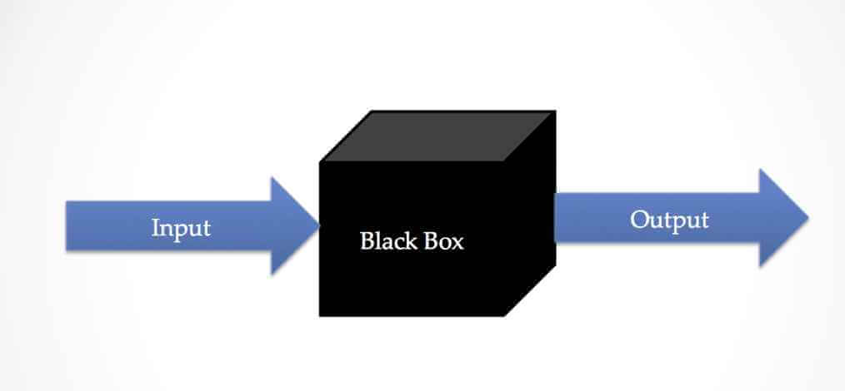
Black-box Testing

Slide 35
Black box Testing Techniques
Equivalence partitioning.
Boundary Value Analysis
Decision table testing
State Transition Testing
Error Guessing

Slide 36
Equivalence Partitioning
Equivalence partitioning divides input data into partitions of equivalent data from which test cases can be derived.
It assumes that all values in each partition should behave the same way.
Example: For a field accepting ages between 1 and 100:
Equivalence partitions: [1-50], [51-100], [<1 (invalid)], and [>100 (invalid)]

Slide 37
Boundary Value Analysis
Boundary Value Analysis focuses on the values at the boundaries of the input domains. It tests the edges of the input ranges as errors often occur at the boundaries.
Example: For a field accepting ages between 1 and 100:
Test cases: 0 (invalid), 1 (valid), 100 (valid), and 101 (invalid)

Slide 38
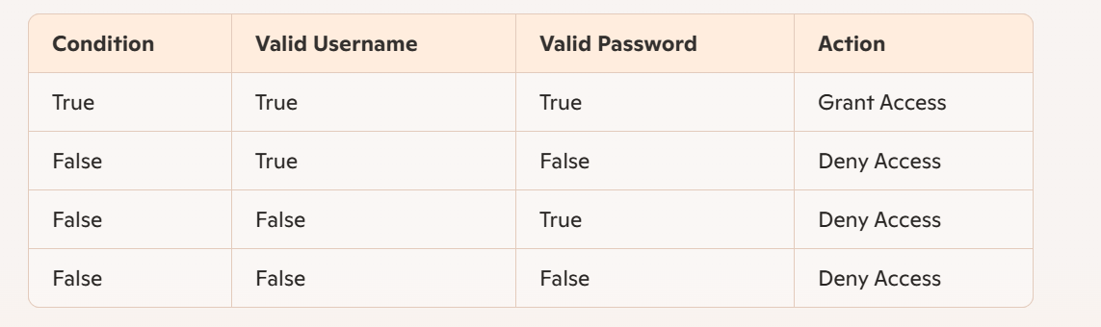
Decision Table Testing
Decision table testing uses a table to represent combinations of inputs and their corresponding outputs, ensuring all possible scenarios are tested.
For a simple login system:

Slide 39
State Transition Testing
State Transition Testing examines the transitions between different states in a system, ensuring that all possible state changes are tested.
Example: For a login system:
States: Logged Out, Logging In, Logged In
Transitions: Logged Out -> Logging In -> Logged In, Logged In -> Logged Out

Slide 40
Error Guessing
Error guessing involves using experience to guess the problematic areas of the application and focusing testing efforts on these areas.
Example: If a field often has issues with special characters, test cases might include inputs like #%&*.

Slide 41
Advantages of Black-Box Testing
More effective on larger units of code than glass box testing
Tester needs no knowledge of implementation, including specific programming languages
Tester and programmer are independent of each other

Slide 42
Black box testing is further divided into
Functional Testing
Non functional Testing

Slide 43
Functional Testing
Functional testing aims to verify that there are no gaps between developed features/functions and required features/functions.
The QA team writes functional test cases. After providing the input, the outputs are verified and the actual results are compared with the expected outcomes.
Functional testing is performed at various levels like
Unit Testing
Integration Testing
System Testing
Acceptance Testing

Slide 44
Non functional Testing
Non-functional testing aims to focus on the non-functional parts of the software like:
Memory leaks
Performance
Toughness
Load
Volume
Scalability
Usability

Slide 45
Software Testing Process
Test case
Test data

Slide 46
Test case design
A Test Case is a set of actions executed to verify a particular feature or functionality of software application.
A Test Case contains test steps, test data, precondition, post condition developed for specific test scenario to verify any requirement.
The test case includes specific variables or conditions, using which a testing engineer can compare expected and actual results to determine whether a software product is functioning as per the requirements of the customer.

Slide 47
Test Case vs Test Data
Test scenarios cover a wide range of possibilities.
Testing is all about being very specific.
For a Test Scenario: Check Login Functionality there many possible test cases are:
Test Case 1: Check results on entering valid User Id & Password
Test Case 2: Check results on entering Invalid User ID & Password
Test Case 3: Check response when a User ID is Empty & Login Button is pressed, and many more
This is nothing but a Test Case.

Slide 48
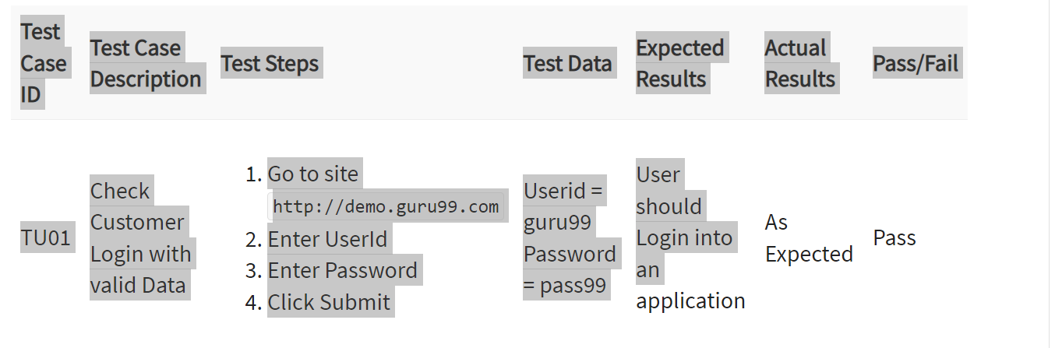
Test Case vs Test data

Slide 49
Regression testing
Regression Testing is defined as a type of software testing to confirm that a recent program or code change has not adversely affected existing features.
Regression Testing is nothing but a full or partial selection of already executed test cases that are re-executed to ensure existing functionalities work fine.
This testing is done to ensure that new code changes do not have side effects on the existing functionalities.
It ensures that the old code still works once the latest code changes are done.

Slide 50
Software inspection
The term software inspection was developed by IBM in the early 1970s, when it was noticed that the testing was not enough sufficient to attain high quality software for large applications.
Software inspection is a process in which other developers or team members review the code written by a developer to identify potential errors or areas for improvement.
This process can help improve the overall quality of the software by identifying and resolving faults early in the development process.

Slide 51
Inspection key Points
Identifying and resolving defects early: By identifying and resolving defects early in the development process, inspection can prevent costly rework and delays later in the project.
Enhancing code readability: Inspection can help improve the readability of the code, making it easier for other developers to understand and maintain.
Improving team collaboration: Inspection can help improve team collaboration by encouraging developers to share their ideas and knowledge.

Slide 52
Inspection key Points
Enhancing code maintainability: Inspection can help identify areas where code is difficult to maintain and suggest improvements to make it more maintainable.
Improving code efficiency: Inspection can help identify areas where code is inefficient and suggest improvements to make it more efficient.
Enhancing security: Inspection can help identify security vulnerabilities in the code and suggest improvements to make the software more secure.
Improving the overall quality of the software: By identifying and resolving defects early in the development process, inspection can help improve the overall quality of the software and ensure that it meets the needs of its users.

Slide 53
Inspection Roles
Author or owner. The programmer or designer responsible for producing the program or document. Responsible for fixing defects discovered during the inspection process.
Inspector. Finds errors, omissions and inconsistencies in programs and documents. May also identify broader issues with the code being inspected such as lack of portability.
Reader. Presents the code or document at an inspection meeting.
Chairman or moderator. Manages the process and facilitates the inspection. Reports process results to the chief moderator.
Scribe. Records the results of the inspection meeting.
Chief moderator. Responsible for inspection process improvements, checklist updating, standards development, etc. Not necessarily involved in all inspections.

Slide 54
Stages In The Software Inspection Process
Planning : The moderator plan the inspection.
Overview Meeting: The background of the work product is described by the author.
Preparation: The examination of the work product is done by inspector to identify the possible defects.
Inspection Meeting: The reader reads the work product part by part during this meeting and the inspectors the faults of each part.
Rework: After the inspection meeting, the writer changes the work product according to the work plans.
Follow Up: The changes done by the author are checked to make sure that everything is correct.

Slide 55
Quality Management
Quality software refers to a software which is reasonably bug or defect free, is delivered in time and within the specified budget, meets the requirements and/or expectations, and is maintainable.
In the software engineering context, software quality reflects both functional quality as well as structural quality.

Slide 56
Quality Planning
Before software development begins, quality planning must take place.
During quality planning, testers create goals and objectives for your software, as well as a strategic plan that will help you to successfully meet those objectives.
Quality planning is considered the most important aspect of SQM, as it develops a strong blueprint for the rest of the process to follow.

Slide 57
Quality Assurance
The quality assurance phase of SQM involves the actual building of the software program.
With good SQM in place, product performance will be checked along the way to ensure that all standards are being followed.
Testers will audit and collect data throughout the entire process.

Slide 58
Quality Control
Quality control is the step of SQM where testing finally comes into play.
It is when testers discover bugs, evaluate functionality, and more. Depending on the results, you may need to go back to development to iron out kinks and make some small final adjustments.
Having a software quality management plan in place can guarantee that you’re following all industry standards and that your end-user will receive a well-developed, high quality product.

Slide 59
Part -2
Software Measurement and Metrices

Slide 60
Software measurement
A measurement is a manifestation of the size, quantity, amount, or dimension of a particular attribute of a product or process.
It is an authority within software engineering.
The software measurement process is defined and governed by ISO Standard.

Slide 61
Need for Software Measurement:
Software is measured to:
Create the quality of the current product or process.
Anticipate future qualities of the product or process.
Enhance the quality of a product or process.
Regulate the state of the project in relation to budget and schedule.

Slide 62
Classification of Software Measurement:
Direct Measurement: In direct measurement, the product, process, or thing is measured directly using a standard scale.
Indirect Measurement: In indirect measurement, the quantity or quality to be measured is measured using related parameters i.e. by use of reference.

Slide 63
Metrics:
A metric is a measurement of the level at which any impute belongs to a system product or process.
Software metrics will be useful only if they are characterized effectively and validated so that their worth is proven.
There are 4 functions related to software metrics:
Planning
Organizing
Controlling
Improving

Slide 64
Characteristics of software Metrics:
Quantitative: Metrics must possess quantitative nature. It means metrics can be expressed in values.
Understandable: Metric computation should be easily understood, and the method of computing metrics should be clearly defined.
Applicability: Metrics should be applicable in the initial phases of the development of the software.
Repeatable: The metric values should be the same when measured repeatedly and consistent in nature.
Economical: The computation of metrics should be economical.
Language Independent: Metrics should not depend on any programming language.

Slide 65
Classification of Software Metrics(Software Quality Metrics)
There are 3 types of software metrics:
Product Metrics: Product metrics are used to evaluate the state of the product, tracing risks and undercover prospective problem areas. The ability of the team to control quality is evaluated.
Process Metrics: Process metrics pay particular attention to enhancing the long-term process of the team or organization.
Project Metrics: The project matrix describes the project characteristic and execution process.
Number of software developer
Staffing patterns over the life cycle of software
Cost and schedule
Productivity

Slide 66
The ISO9000 quality standards
ISO (International Standards Organization) is a group of 63 countries established to plan standardization.
ISO declared its 9000 series of standards in 1987.
It serves as a reference for the contract between independent parties.
The ISO 9000 standard determines the guidelines for maintaining a quality system.
The ISO standard mainly addresses operational methods and organizational methods such as responsibilities, reporting, etc.
ISO 9000 defines a set of guidelines for the production process and is not directly concerned about the product itself.

Slide 67
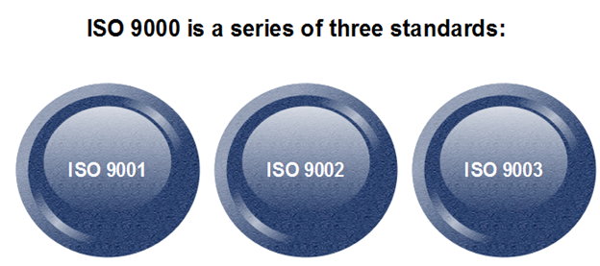
Types of ISO 9000 Quality Standards

Slide 68
Types of ISO 9000 Quality Standards
ISO 9001: This standard applies to the organizations engaged in design, development, production, and servicing of goods. This is the standard that applies to most software development organizations.
ISO 9002: This standard applies to those organizations which do not design products but are only involved in the production. Examples of these category industries contain steel and car manufacturing industries that buy the product and plants designs from external sources and are engaged in only manufacturing those products. Therefore, ISO 9002 does not apply to software development organizations.
ISO 9003: This standard applies to organizations that are involved only in the installation and testing of the products. For example, Gas companies.

Slide 69
How to get ISO 9000 Certification?
Application: Once an organization decided to go for ISO certification, it applies to the registrar for registration.
Pre-Assessment: During this stage, the registrar makes a rough assessment of the organization.
Document review and Adequacy of Audit: During this stage, the registrar reviews the document submitted by the organization and suggest an improvement.
Compliance Audit: During this stage, the registrar checks whether the organization has compiled the suggestion made by it during the review or not.
Registration: The Registrar awards the ISO certification after the successful completion of all the phases.
Continued Inspection: The registrar continued to monitor the organization time by time.

Slide 70
Capability Maturity Model
CMM was developed by the Software Engineering Institute (SEI) at Carnegie Mellon University in 1987.
It is not a software process model. It is a framework that is used to analyze the approach and techniques followed by any organization to develop software products.
It also provides guidelines to further enhance the maturity of the process used to develop those software products.
It is based on profound feedback and development practices adopted by the most successful organizations worldwide.
This model describes a strategy for software process improvement that should be followed by moving through 5 different levels.

Slide 71
Key Process Areas (KPA’s):
Each of these KPA’s defines the basic requirements that should be met by a software process in order to satisfy the KPA and achieve that level of maturity.

Slide 72
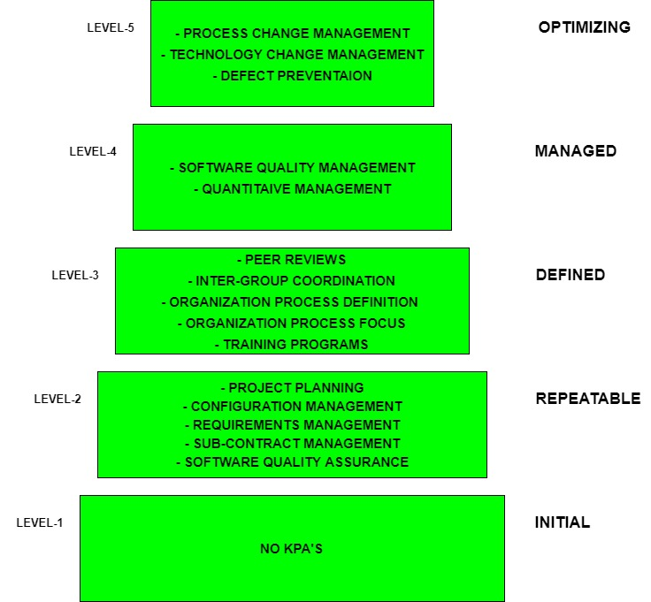
Five levels of CMM

Slide 73
Level-1: Initial
Processes are Adhoc and immature and are not well defined.
Unstable environment for software development.
No basis for predicting product quality, time for completion, etc.
Limited project management capabilities, such as no systematic tracking of schedules, budgets, or progress.
Limited communication and coordination among team members and stakeholders.
No formal training or orientation for new team members.
Little or no use of software development tools or automation.
Highly dependent on individual skills and knowledge rather than standardized processes.
High risk of project failure or delays due to lack of process control and stability.

Slide 74
Level-2: Repeatable
Focuses on establishing basic project management policies.
Experience with earlier projects is used for managing new similar natured projects.
Project Planning- It includes defining resources required, goals, constraints, etc. for the project. It presents a detailed plan to be followed systematically for the successful completion of good quality software.
Configuration Management- The focus is on maintaining the performance of the software product, including all its components, for the entire lifecycle.
Requirements Management- It includes the management of customer reviews and feedback which result in some changes in the requirement set. It also consists of accommodation of those modified requirements.
Subcontract Management- It focuses on the effective management of qualified software contractors i.e. it manages the parts of the software which are developed by third parties.
Software Quality Assurance- It guarantees a good quality software product by following certain rules and quality standard guidelines while developing.

Slide 75
Level-3: Defined
At this level, documentation of the standard guidelines and procedures takes place.
It is a well-defined integrated set of project-specific software engineering and management processes.
Peer Reviews- In this method, defects are removed by using a number of review methods like walkthroughs, inspections, buddy checks, etc.
Intergroup Coordination- It consists of planned interactions between different development teams to ensure efficient and proper fulfillment of customer needs.
Organization Process Definition- Its key focus is on the development and maintenance of the standard development processes.
Organization Process Focus- It includes activities and practices that should be followed to improve the process capabilities of an organization.
Training Programs- It focuses on the enhancement of knowledge and skills of the team members including the developers and ensuring an increase in work efficiency.

Slide 76
Level-4: Managed
At this stage, quantitative quality goals are set for the organization for software products as well as software processes.
The measurements made help the organization to predict the product and process quality within some limits defined quantitatively.
Software Quality Management- It includes the establishment of plans and strategies to develop quantitative analysis and understanding of the product’s quality.
Quantitative Management- It focuses on controlling the project performance in a quantitative manner.

Slide 77
Level-5: Optimizing
This is the highest level of process maturity in CMM and focuses on continuous process improvement in the organization using quantitative feedback.
Use of new tools, techniques, and evaluation of software processes is done to prevent recurrence of known defects.
Process Change Management- Its focus is on the continuous improvement of the organization’s software processes to improve productivity, quality, and cycle time for the software product.
Technology Change Management- It consists of the identification and use of new technologies to improve product quality and decrease product development time.
Defect Prevention- It focuses on the identification of causes of defects and prevents them from recurring in future projects by improving project-defined processes.

Slide 78
Assignment
1. What is programming language? Explain various software development tools.
2.Explain good programming practices used in software development?
3. What do you mean by verification and validation? Explain software inspection process with block diagram.
4. What do you mean by software testing? Differentiate between black box testing and white box testing.
5. Explain different levels of software testing.
6. What do you mean by test case and test data? Explain software testing process.
7. Define quality management. Explain quality management activities.
8. Explain Capability maturity model with block diagram?
9. What do you mean by quality standard? Explain ISO9000 model.
10. What is regression testing.

